Slide 1

AOOP - Project
Online Voting System

Slide 2

Team Members
Sumeet Sharma 2110030031
T.Chandra Sekhar 2110030138
Amaan Hussain 2110030093

Slide 3



1. Intro
This project is an online voting application.Users cast their vote and its recorded. Finally, the results are displayed.
It’s an alternative to the present mode of election. Users can vote at the comfort of their home

Slide 4
About
Online Election System would have Candidate registration, document verification, auto-generated User ID and pass for candidate and Voters.
Admin Login which will be handled by Election Commission .Candidate Login which will be handled By Candidate, Voters will get Unique ID and Password.
The software system allows the Candidate to login in to their profiles and upload all their details including their previous milestone onto the system.
The software system allows Voters to view a list of Candidates in their area.
The admin has overall rights over the system and can moderate and delete any details not pertaining to Election Rules.

Slide 5
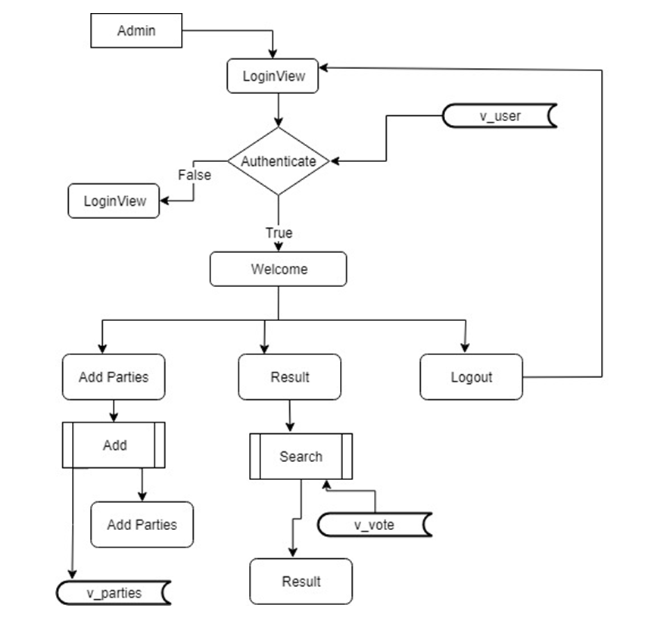

Slide 6
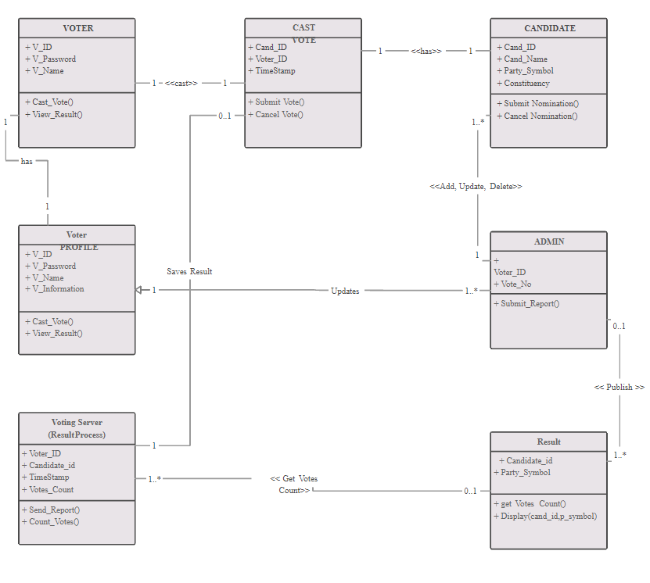

Slide 7
Key features :
The votes of the users is encrypted.
The admin can also remove the users if he/she violates election rules.
At the end, the results are released by the admin to the public.

Slide 8
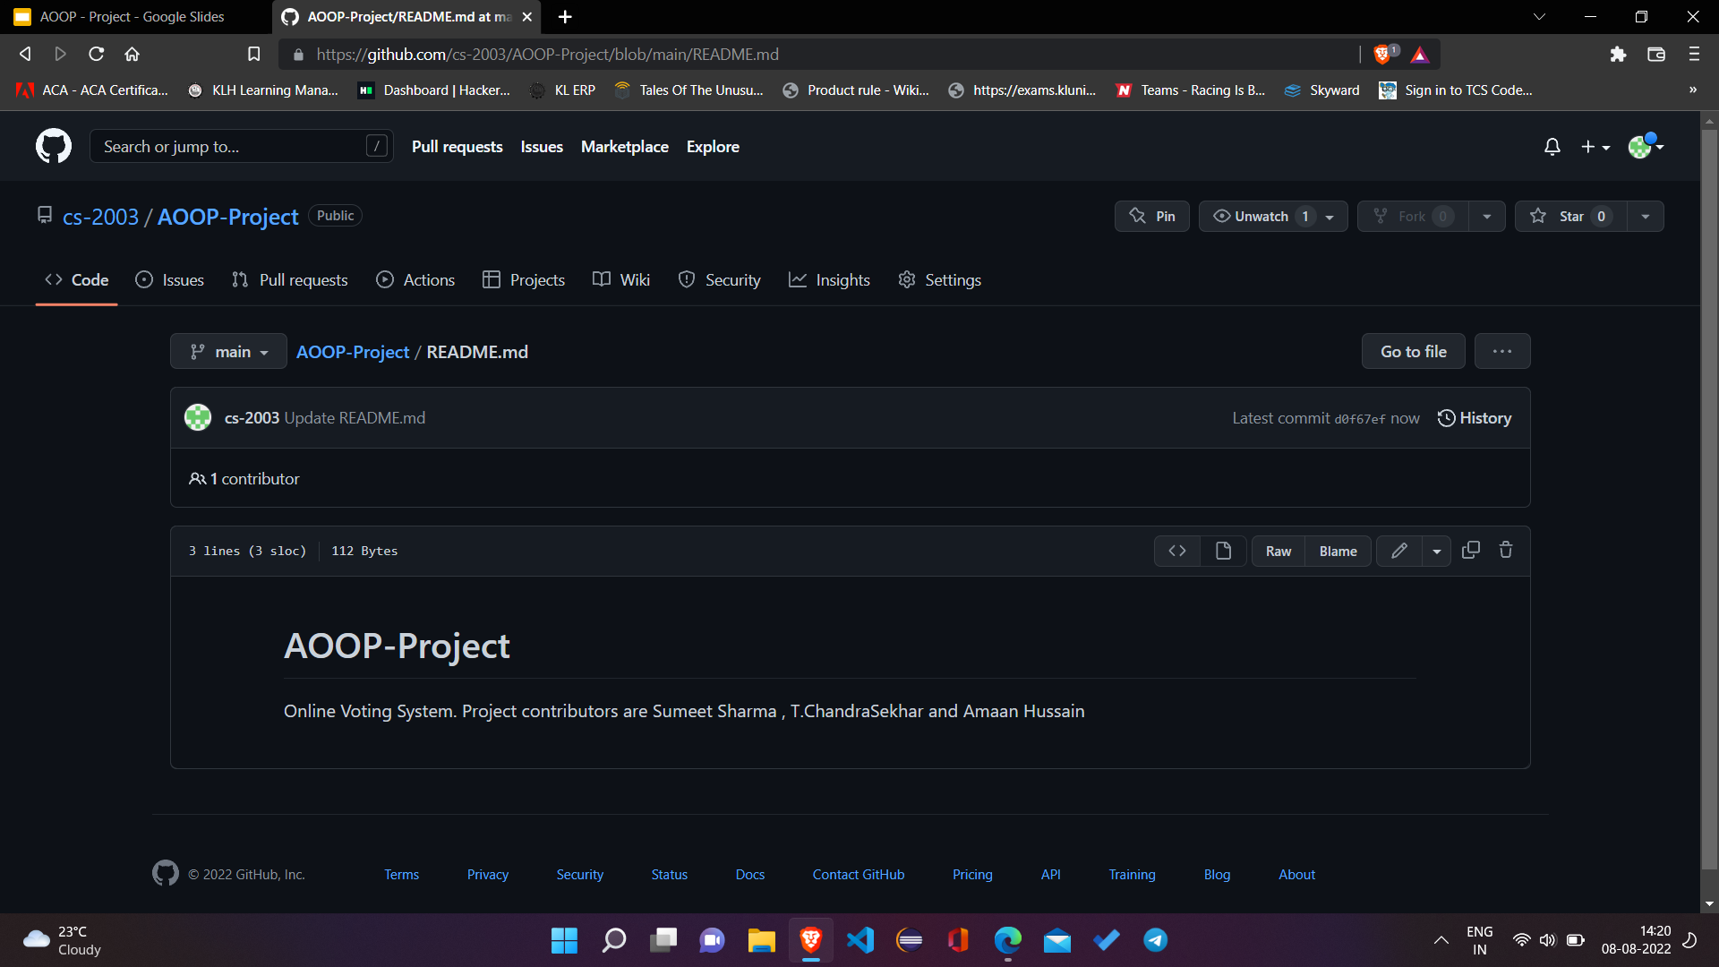
GitHub Repository

Slide 9


